Slide 1


Slide 2
Philanthro.Me
Matthew Peck, David Martinez, Mason Hendricks, Quinton Miller

Slide 3

Inception
Idea for a charity database was first pitched by Matthew, and we ran with it from the beginning.
We began brainstorming ideas for services the website would provide, including:
Charity donation
Account creation
Verification for charities and high profile accounts
Organizations and fundraising events
Much more
Certain logistics involving security came into question, but most of that would not have to be dealt with until much later down the line.
All in all the idea became well-rounded very quickly, and it is something that could be implemented in real life with relative success since there is nothing like it yet.

Slide 4
Requirements
We quickly planned out the types of users that would be accessing the site, as well as which pages they would have access to.
This allowed us to figure out how many pages we would need to design, and what information would be available to access and input on each page.
Some of the pages we needed to design include:
A dashboard
Fundraiser profile and creation pages
User Profile and creation pages
Subscriptions page
Payment page
Our UI would have to be intuitive and fit basic requirements like always having a homepage button, and all pages being easily accessible from any other page.
Discussions about this were held in class, and it wouldn’t be until the Design step that serious deliberations commenced.

Slide 5
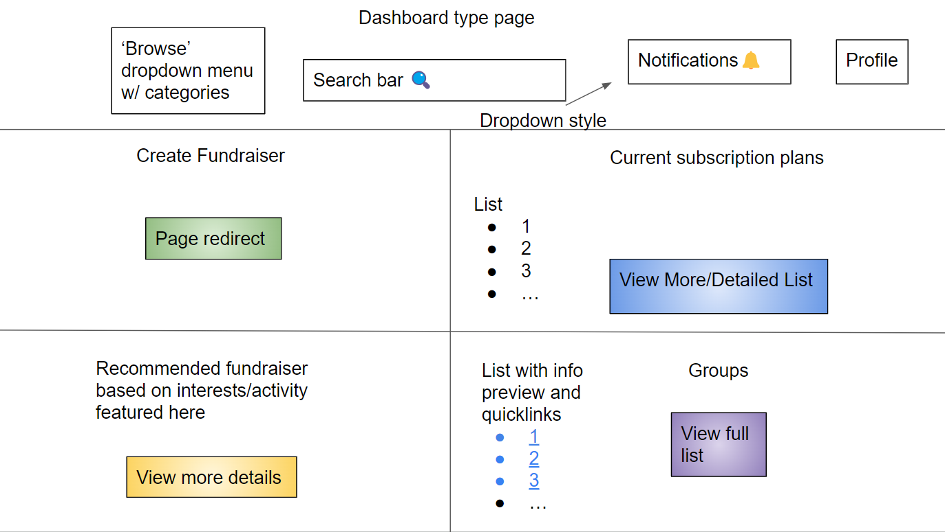
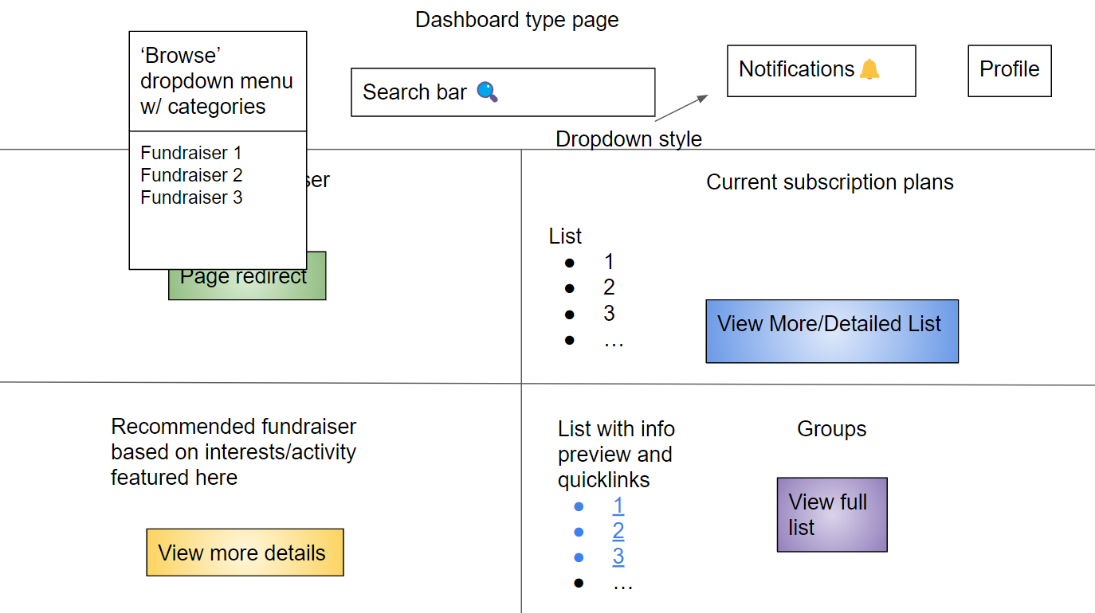
Design Pre-Development
Our original ideas for design involved the basic functionality we wanted to implement.
We started with crude UI designs that allowed for easy access to any option needed for that page.
We also used basic slideshow mechanics to switch from slide to slide, and imitate the ability to open dropdown menus.
Pages and UI mechanics we implemented include:
Dashboard - Pictured to the right
Back buttons
Pages for fundraiser info, as well as fundraiser creation
Pages for profile info, as well as profile creation
Donation page, with the proper payment info laid out
This crude but detailed design allowed us to go into development with a clear idea of what we needed to do for each page.

Slide 6
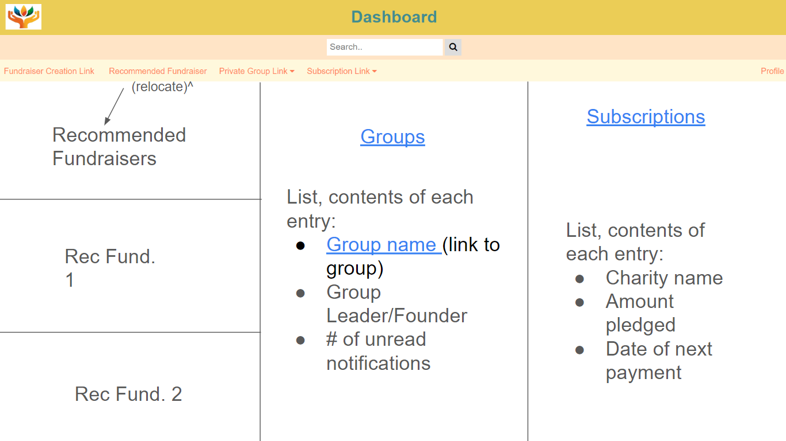
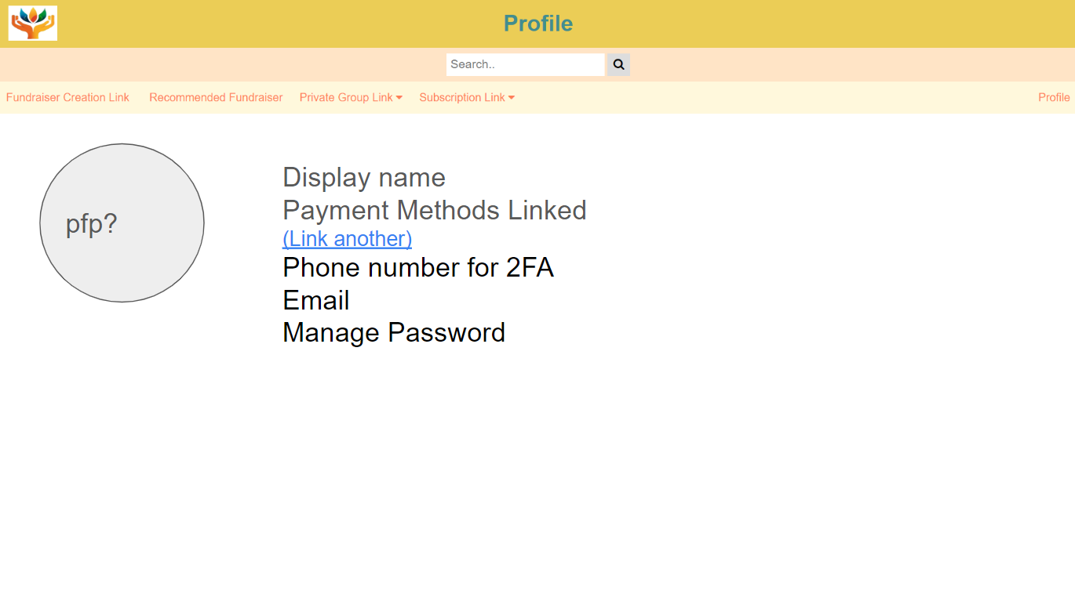
Design Post-Development
After we began working with HTML to develop the working version of the website, we realized the mock-ups we had previously made were too bare bones.
We would have to recreate the pages in a way that is more visually pleasurable, and that has a more intuitive UI.
We looked for positive colors, and came up with the light orange and aquamarine combo that we are currently using.
This color combination also matches the symbol that we use for our website. This symbol was generated using Dall-e 2.
Our new UI, depicted to the right, had much more concise information, and was generally less busy allowing for an easier user experience.
We also included much more organized plans as to what information is where, and which links lead to which pages.

Slide 7
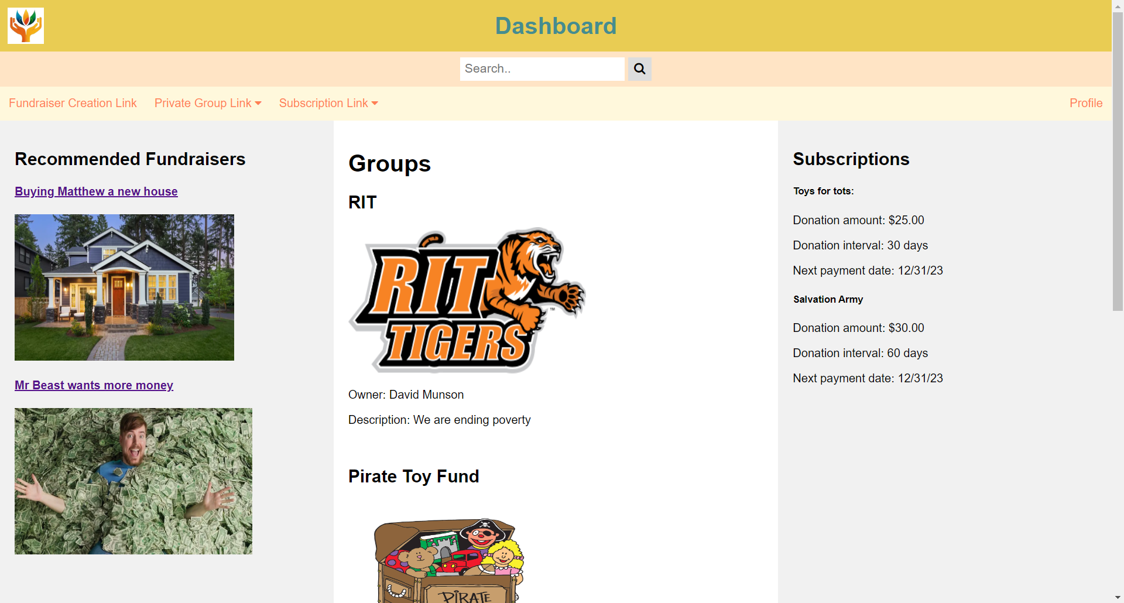
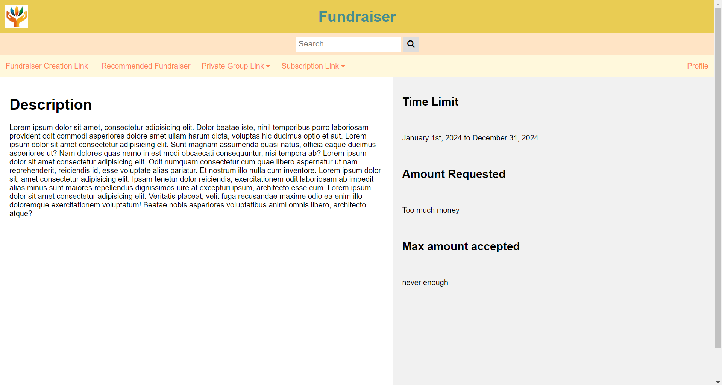
Construction
The construction process, as mentioned before, we began with the design of the header.
It was quickly figured out how to make additions like:
A subheader with links to other pages
A search bar
An image of our logo that links back to the dashboard
A similar header across all pages
We considered making the search bar functional, but since in our case there will never be a database of charities for it to search through, we decided against figuring out how to make a functional search bar.
We then created a tri-columned main section for the dashboard, as well as filled in the many other pages with the UI that we designed previously.

Slide 8
Demo

Slide 9
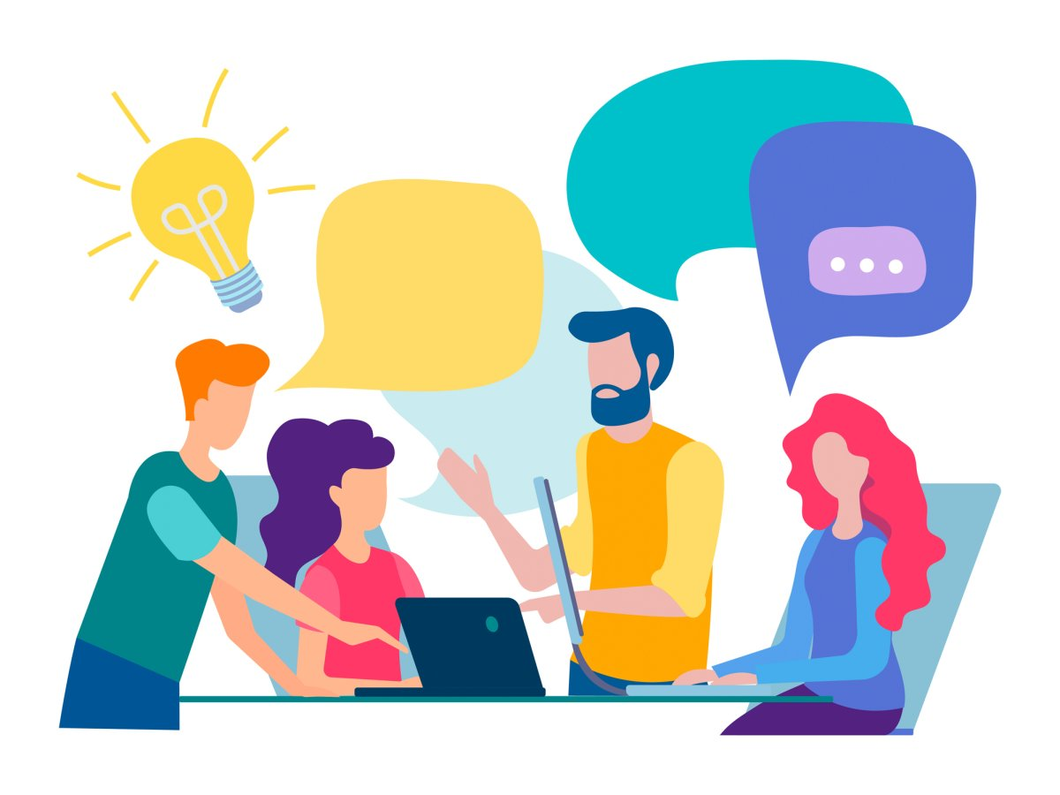
Summary and Reflection
Over the course of this project we learned many valuable lessons in team structure and organization.
Besides technical skills like proficiencies in HTML, VS Code, and basic knowledge of CSS, learning how to team build has become one of the most defining skills of this project.
Advice we would give is to make sure that work is properly divided between team members, so that everyone knows what they are doing and who they are communicating with.
Another obvious piece of advice would be to start working on the project earlier rather than later.

Slide 10
Thank you!
Q & A

